Slide 1
Language Processor

Slide 2
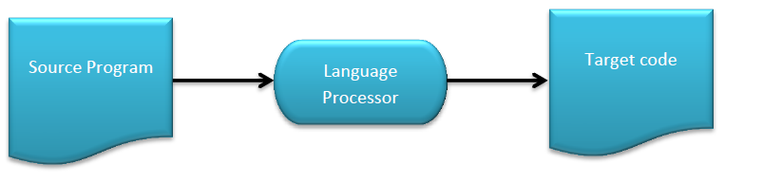
Language Processor
Language processors are programs that can read a program in one language and convert it to an equivalent program in another language.
7/29/15
1
Notes:
1

Slide 3
Language Processor
Language Processing activities arise due to the diff between the manner in which a software designer describes the ideas and the manner in which ideas are implemented in a computer system.
The designer express their ideas in terms of application domain of software domains. To implement these ideas, their description need to be interpreted in terms related to the Execution domain.
Semantic Gap
Application Domain
Execution Domain
1
Notes:
1
Application Domain : The designer expresses the ideas in terms related to the application domain.
Execution Domain : To implement these ideas, their description has to be interpreted in terms related to the execution domain.
Semantic : We use the term semantics to represent the rules of meaning of a domain.
Semantic Gap : To represent the difference between the semantics of two domains.

Slide 4
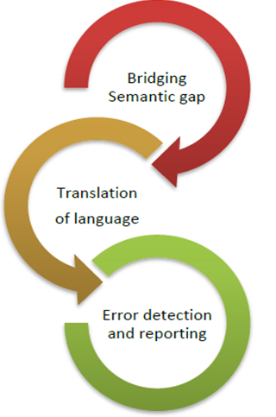
Purpose of Language Processor
Language Processors has mainly Three purposes:
Bridge gap between Application Domain and Execution Domain
Translation from one language to another
To detect error in source during translation.
1
Notes:
1

Slide 5
Introduction to System Programming
Specification gap
Execution gap
Application domain
PL
domain
Execution domain
Notes:
1

Slide 6
Types Of Software
Bridged by designer of programming lang processor
Bridged by s/w devnt team
Specification Gap
Execution Gap
Application Domain
PL Domain
Execution Domain
Notes:
1
Consequences of semantic gap – large development times, large development efforts, poor quality of s/w
Can be tackled by Programming Languages (PLs).
1. Bridge Gap between Application domain and execution domain
As computers only understand machine language and it is not plausible by humans to understand machine codes. So a software designer describes the ideas concerning software in terms related to application domain, usually in high-level languages.
This description needs to be interpreted to machine level languages, i.e. in terms related to execution domain. The rules of each domain (semantics) vary and therefore this difference is called semantic gap.
A Language processor is used for:
1. Specification, design and coding steps.
2. PL Implementation steps.
The gaps b/w both the domains are bridged by introducing a new domain PL Domain. By introducing this new domain the software designer need to take care of only bridging specification gap i.e. gap b/w Application domain and PL Domain, while the translator takes care of execution gap.[
Software engineering steps aimed at the use of a PL can be grouped into
1. Specification, design and coding steps.
2. PL implementation steps.

Slide 7
Spectrum of language processors:
Language translator : Bridges an execution gap to the machine language. (e.g. .Net CLR)
Assembler :
Compiler :
Detranslator : Translator working in either direction.
Preprocessor : Is a language processor which bridges execution gap but is not a language translator.
Language migrator : bridges the specification gap between two PLs.
Interpreter : Is a language processor which bridges an execution gap without generating a machine language program.
1
Notes:
1
A systems programmer installs, customizes and maintains the operating system
To do this they need knowledge of
Hardware
Storage
Processor
Software
System libraries and data sets
Current customization

Slide 8
Language Processing Activities
Fundamental language processing activities can be divided into those that bridges the specification gap and those that bridges the execution gap.
i.e.
1. Program generation activities
2. Program execution activities
Notes:
1

Slide 9

Errors
C++ Program
C++ Preprocessor
C
Program
Errors
C++ Program
C++ Translator
Machine language program
Notes:
1
1

Slide 10
Language Processing Activities
Program Generation Activities:
It aims at automatic generation of a program.
Should be error free and perfect
Errors
Program Specification
Program Generator
Program in target PL
Notes:
1
Program generation activities
A program generation activity aims at automatic generation of a program.
A source language is a specification language of an application domain and the target language is procedure oriented PL.
Program generator introduces a new domain between the application and PL domain , call this the program generator domain.
Specification gap now between Application domain and program generation domain, reduction in the specification gap increases the reliability of the generated program.
The program generator is a software system which accepts the specification of a program to be generated, and generates a program in the target PL. We call this the program generator domain. The specification gap is now the gap between the application domain and the program generator domain. This gap is smaller than the gap between the application domain and the target PL domain.
Reduction in the specification gap increases the reliability of the generated program. Since the generator domain is close to the application domain, it is easy for the designer or programmer to write the specification of the program to be generated.

Slide 11
Language Processing Activities
Program Execution Activities
Two popular model
Program Translation
Program Interpretation
Program Translation
It bridges the execution gap by translating a program written in a PL, called source Program (SP), into an equivalent program in the machine or assembly language, called target program.
Characteristics of the program translation model:
A program must be translated before it can be executed.
The translated program may be saved in a file. The saved program may be executed repeatedly.
A program must be retranslated following modifications.

Slide 12
Language Processing Activities
Program Execution Activities
Two popular model
Program Translation
Program Interpretation
Program Interpretation:
Interpretation cycle
1. Fetch the statement.
2. Analyze the statement and determine its meaning
3. Execute the meaning of statement
4. Change PC and repeat the cycle
i.e. After interpretation, source program is retained in the source form itself, means, no target program form exists.

Slide 13
Language Processing Activities
The program translation model bridges the execution gap by translating a sources program into program in the machine or assembly language of the computer system, called target program.
Source Program
Translator
m/c Language program
Target Program

Slide 14
Interpretation vs Execution
Interpreter
Memory
CPU
Memory
PC
Source Program
+
Data
PC
Machine language Program
+
Data
Errors
Interpretation
Program execution
Notes:
<number>

Slide 15
Program Interpretation Cycle
Interpretation cycle
1. Fetch the statement.
2. Analyze the statement and determine its meaning
3. Execute the meaning of statement
4. Change PC and repeat the cycle
i.e. After interpretation, source program is retained in the source form itself, means, no target program form exists.

Slide 16
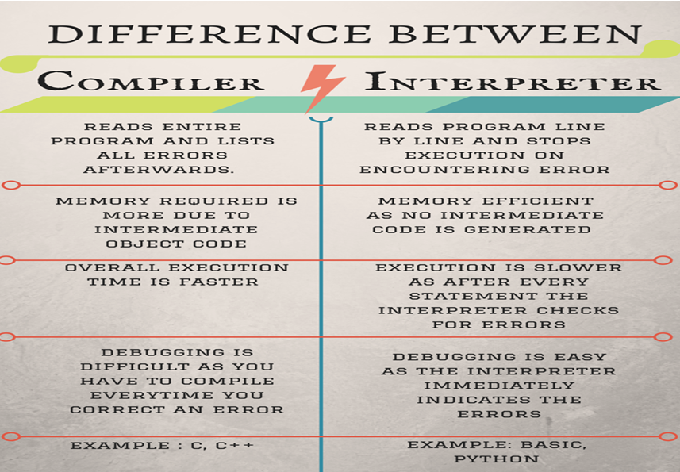

Slide 17
Phases of Language Processor
Language Processing = Analysis of SP + Synthesis of TP
Source Program
Language Processor
Target Program
Analysis Phase
Synthesis Phase
Errors
Errors

Slide 18
Phases of Language Processor
Analysis Phase
The specification consists of three components:
Lexical rules which govern the formation of valid lexical units in the source language.
Syntax rules which govern the formation of valid statements in the source language.
Semantic rules which associate meaning with valid statements of the language.

Slide 19
Phases of Language Processor
Consider the following example:
percent_profit = (profit * 100) / cost_price
Lexical units identifies =, * and / operators, 100 as constant, and the remaining strings as identifiers.
Syntax analysis identifies the statement as an assignment statement with percent_profit as the left hand side and (profit * 100) / cost_price as the expression on the right hand side.
Semantic analysis determines the meaning of the statement to be the assignment of profit * 100 / cost_price to percent_profit.

Slide 20
Phases of Language Processor
Synthesis Phase
The specification consists of three components:
Lexical rules which govern the formation of valid lexical units in the source language.
Syntax rules which govern the formation of valid statements in the source language.
Semantic rules which associate meaning with valid statements of the language.

Slide 21
Phases of Language Processor
Synthesis Phase
The synthesis phase is concerned with the construction of target language statements which have the same meaning as a source statement.
It performs two main activities:
Creation of data structures in the target program (memory allocation)
Generation of target code (code generation)

Slide 22
Phases of Language Processor
Language Processor
Analysis of source statements can not be immediately followed by synthesis of equivalent target statements due to following reasons:
Forward References
Issues concerning memory requirements and organization of a LP
Source Program
Analysis Phase
Synthesis Phase
Target Program
Errors
Errors

Slide 23
Forward Reference
It is a reference to the entity which precedes its definition in the program. Using a variable before a value is assigned to it is called a forward reference.
Forward referenced variables have the scope of the location where they are first referenced. They cannot be read before a value has been assigned to them, but they can be used for further forward reference.

Slide 24
Language Processor Pass
Pass I : performs analysis of Sorce Program and notes relevant information.
Pass II : performs synthesis of target program.
Pass I analysis Source Program and generates IR which is given as input to Pass II to generate target code.

Slide 25
Intermediate Representation (IR)
An IR reflects the effect of some but not all, analysis and synthesis tasks performed during language processing.
Front End
Back End
Source Program
Target Program
Intermediate Representation (IR)

